Slide 1
Lecture 01 Introduction
CS397/497 – Wireless Protocols for IoT
Branden Ghena – Spring 2022
Materials in collaboration with Pat Pannuto (UCSD)

Slide 2
COVID Update - Spring 2022 Edition
Masks in class are no longer mandatory
You’re still welcome to wear one if you want, but I won’t make you
I’ll still be wearing one
If you are sick, do not come to class
We will be flexible with deadlines as necessary
Lectures are being recorded automatically

Slide 3
Welcome to CS397/497!
~37 students (25 undergrad, 12 grad)
Lots of different backgrounds and interests
This is going to be like a graduate course
No exams!
Occasional paper reading
Majority of your grade is the final project
This course is based on discussion and questions
Expect to attend classes, ask questions, and interact with others
You’re hopefully here because you want to be and want to learn

Slide 4
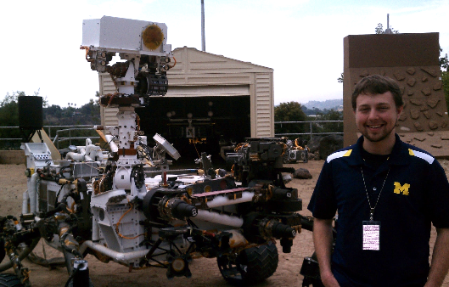
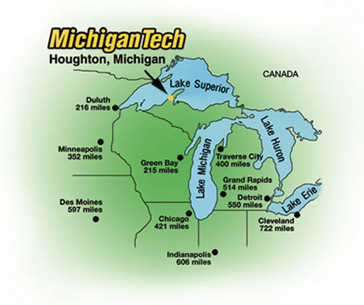
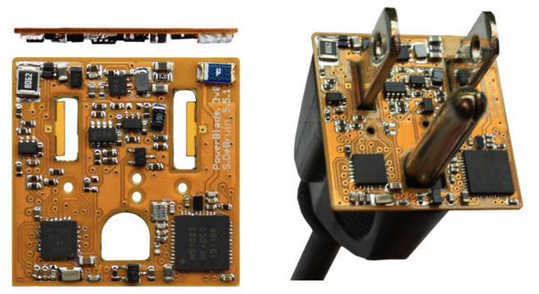
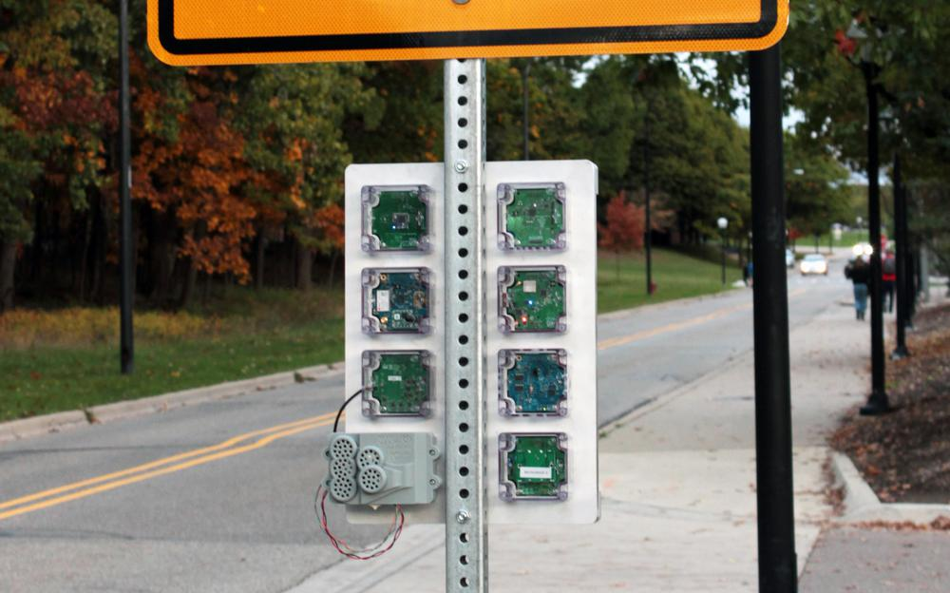



Branden Ghena (he/him)
Assistant Faculty of Instruction
Education
Undergrad: Michigan Tech
Master’s: University of Michigan
PhD: University of California, Berkeley
Research
Resource-constrained sensing systems
Low-energy wireless networks
Embedded operating systems
Teaching
Computer Systems
CS211: Fundamentals of Programming II
CS213: Intro to Computer Systems
CS343: Operating Systems
CE346: Microprocessor System Design
CS397: Wireless Protocols for the IoT
Things I love

Slide 5
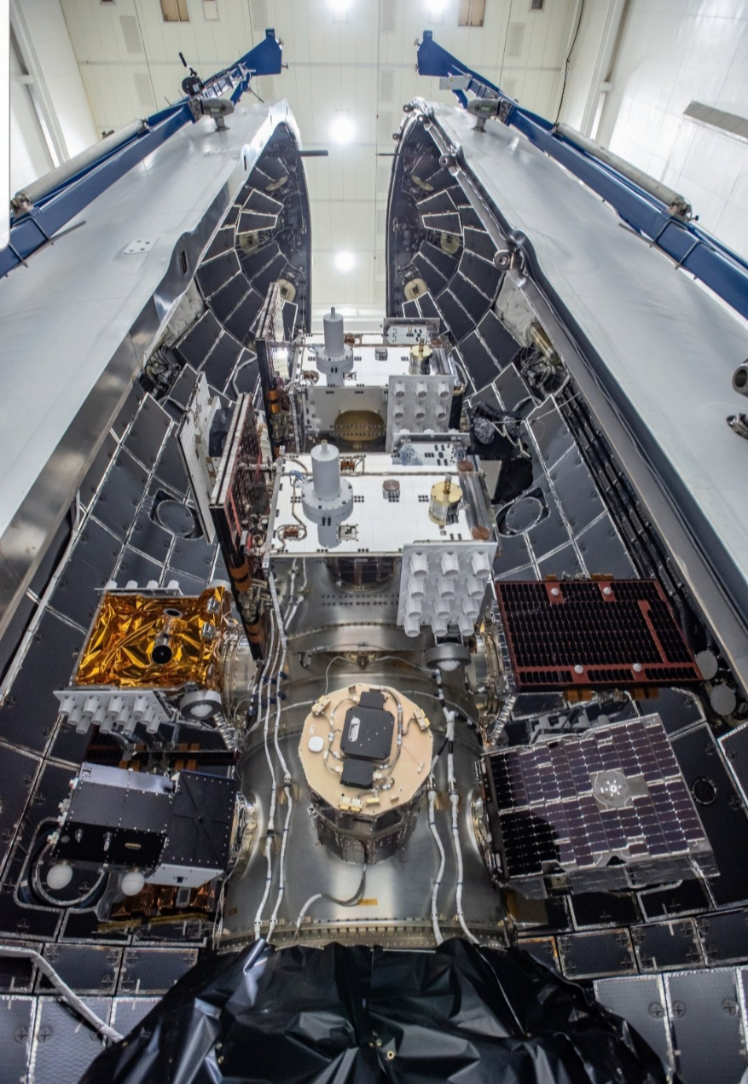
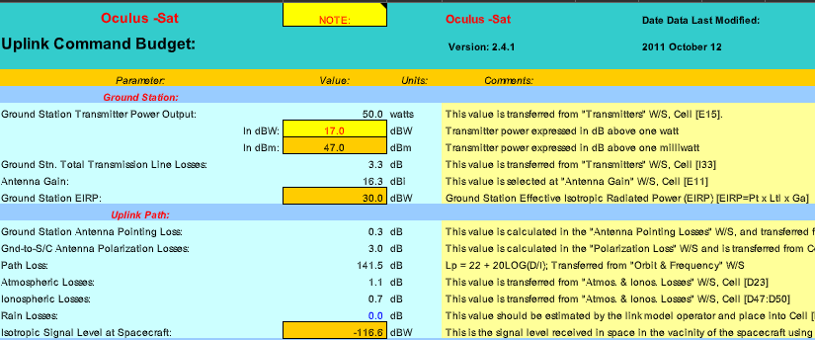
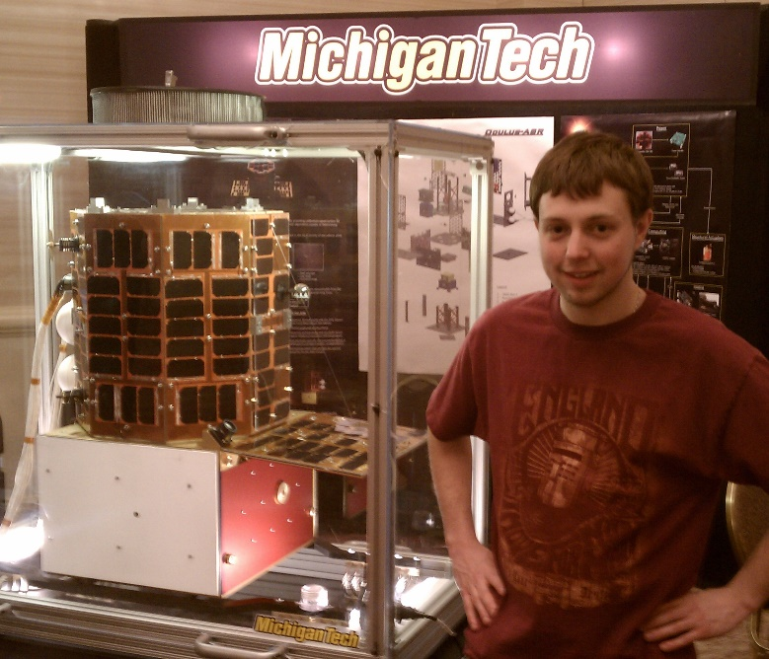
Undergraduate: satellite radios and computers
How the heck are you supposed to learn this stuff?

Slide 6

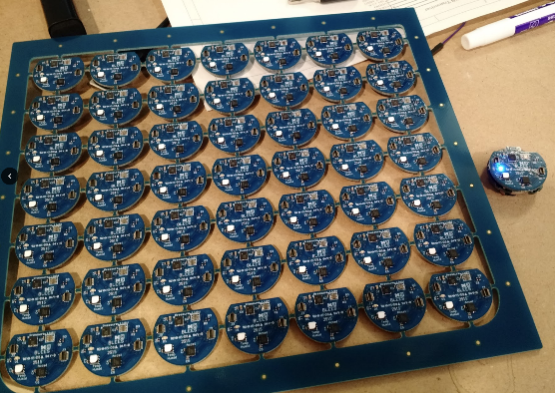
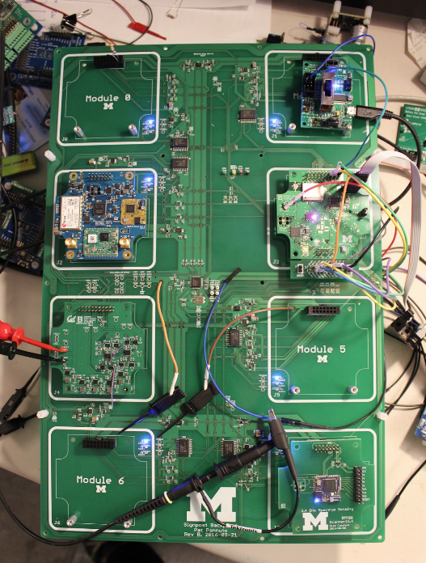
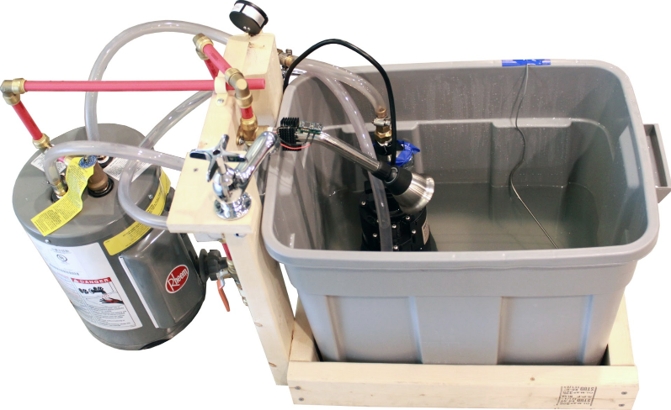
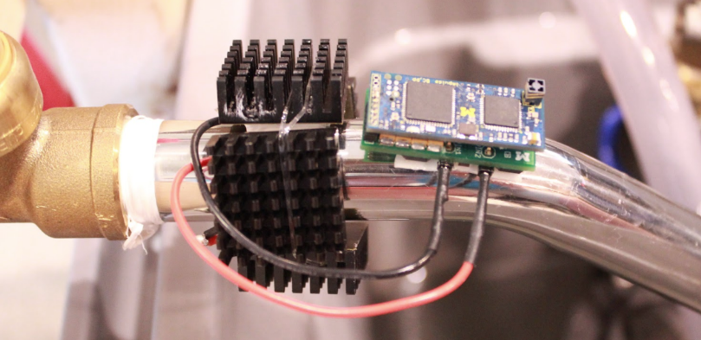
Grad school: resource-constrained embedded systems
Most interesting to me: the interfaces
Hardware and software
Applications and OS
Communication
Again: learn by doing
With significant assistance from my peers

Slide 7
Faculty: now I can choose what to teach!
Goal: provide classes that teach more advanced embedded systems topics
Hopefully, generally useful to other nearby domains of CS and ECE too!
Result: this course!
Course goals: make students familiar with a number of different wireless protocols and their tradeoffs
Practical hands-on experience with some networks
Open-ended project where students can choose their specific focus

Slide 8
Today’s Goals
Overview of the course
Introduction to the Internet of Things
Introduction to wireless communication

Slide 9
Outline
Who and Why
Internet of Things
Course Overview
Overview of wireless networks

Slide 10
Perspective of this course
This class is about wireless protocols
For a specific domain: the Internet of Things
So we’ll spend some amount of time discussing the Internet of Things and embedded systems

Slide 11
Discussion: what is the Internet of Things?
Name a few Internet of Things devices
What are the qualities that designate those devices at “IoT”?

Slide 12
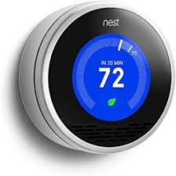
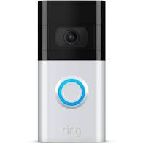


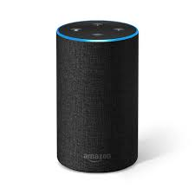
Discussion: what is the Internet of Things?
Name a few Internet of Things devices
What are the qualities that designate those devices at “IoT”?

Slide 13
Thought experiment on capabilities
What if the Nest thermostat was powered by an entire desktop?
8-core x86-64 processor, 32 GB RAM, 1 TB SSD
Would that still count as IoT?
Why don’t we see that in practice?

Slide 14
Thought experiment on capabilities
What if the Nest thermostat was powered by an entire desktop?
8-core x86-64 processor, 32 GB RAM, 1 TB SSD
Would that still count as IoT?
Why don’t we see that in practice?
Cost

Slide 15
Thought experiment on energy
IoT devices include a mix of batteries, wall power, (and energy-harvesting)
Why do we put so much focus on systems with batteries?
Why do they need batteries?

Slide 16
Thought experiment on energy
IoT devices include a mix of batteries, wall power, (and energy-harvesting)
Why do we put so much focus on systems with batteries?
Why do they need batteries?
Deployability

Slide 17
Largest IoT challenges: power and communication
This class is about wireless technologies
For resource-constrained systems, such as the IoT
We will focus on the tradeoffs between technologies
How they balance differing constraints
Power, spectrum, complexity, etc.
And the technical foundations of these designs and differences

Slide 18
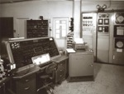
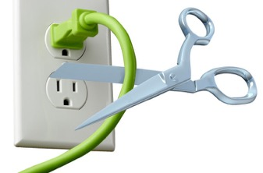
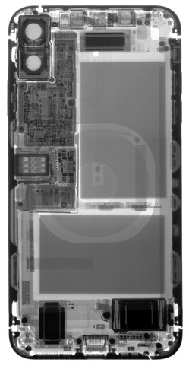
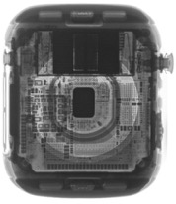
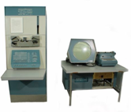

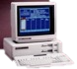
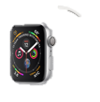

Energy is the defining constraint of emerging technologies
Mainframe
Computer
Workstation
By volume, the emerging computing classes are mostly energy storage
Volume is shrinking cubically
Laptop
Mini Computer
Battery
IoT/Wearable
Personal Computer
Smartphone
Notes:
Defining feature of modern computing classes is the amount of energy storage required to allow their operation
Clip art: http://www.ctecsolar.com/cut-cord-electric-company/
X-rays: iFixit teardowns

Slide 19
Branden’s take on the Internet of Things
Key features
Computation
Local to the device
With some capability for arbitrary compute and storage
Connectivity
Almost certainly wireless
Likely Internet, possibly local
Interaction
Sensing or Actuation
Secondary features
Low energy
(Relatively) Low cost

Slide 20
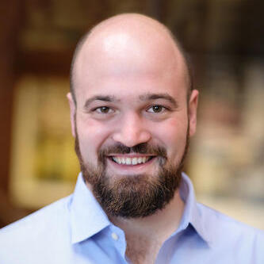
Pat Pannuto’s take on the Internet of Things
His early grad school essays described the “last inch” problem
Now he often says “expanding the reach of digital world”
For him, it is about ‘networked’ ‘things’
Which implicitly adds some computational capacity
[Though not always? Backscatter sensors break this definition…]
Assistant Professor, UC San Diego
https://patpannuto.com/

Slide 21
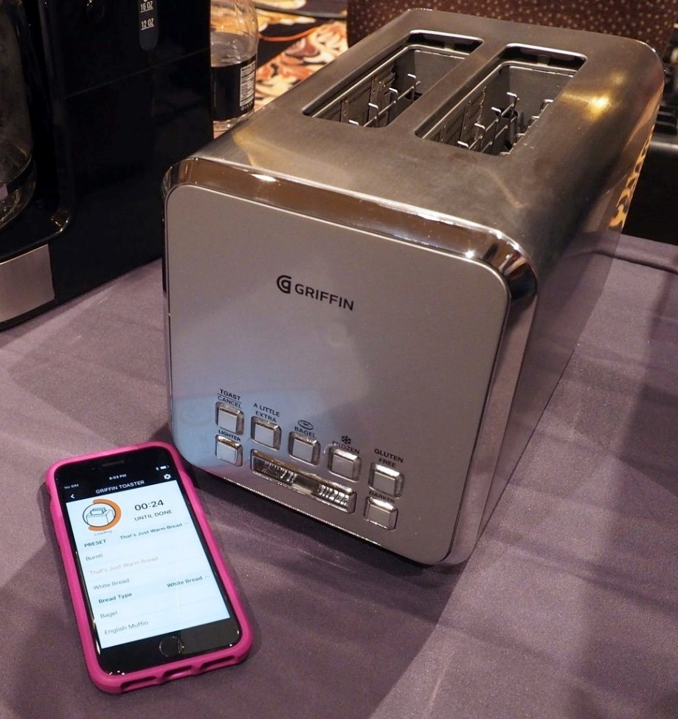
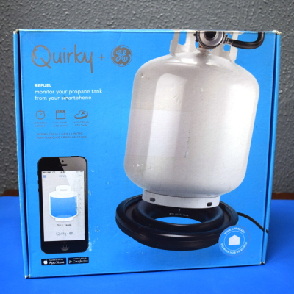
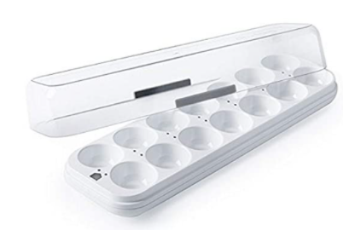
Warning: Internet of Crap

Slide 22
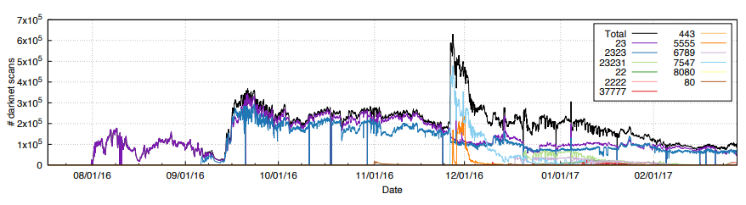
Internet of Insecure Crap
Mirai botnet (2016)
Takes control of up to 600,000 insecure connected devices
IP-attached cameras, DVRs, routers, printers
Used to DoS websites

Slide 23
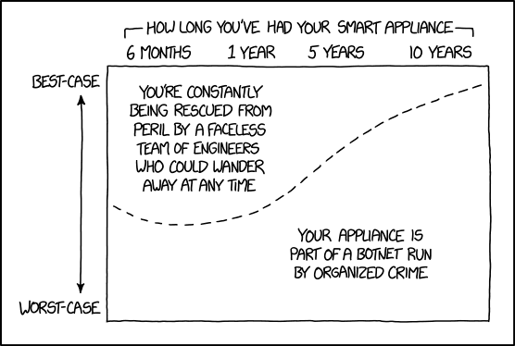
Break + xkcd
https://xkcd.com/1966/

Slide 24
Outline
Who and Why
Internet of Things
Course Overview
Overview of wireless networks

Slide 25
Asking questions
Class and office hours are always an option!
Office hours by demand. I promise to meet!!
Campuswire: (similar to piazza)
Post questions
Answer each other’s questions
Find lab partners
Information from the course staff
Post private info just to course staff
Please do not email me! Post to Campuswire instead!
I’ll be updating roster again a few times

Slide 26
Grading
Seriously, no exams or homework or participation points
The point of in-class material is to teach you and prepare you for projects
Come because you want to learn it
35% Lab projects
Likely 7 of these, divided equally
65% Final project
10% Proposal
05% Update Meeting
10% Presentation
10% Paper
30% Project Quality

Slide 27
Grading
Seriously, no exams or homework or participation points
The point of in-class material is to teach you and prepare you for projects
Come because you want to learn it
35% Lab projects
Likely 7 of these, divided equally
65% Final project
10% Proposal
05% Update Meeting
10% Presentation
10% Paper
30% Project Quality

Slide 28
Labs
Practice interacting with and considering networks
Sometimes getting real hardware working
BLE Scanning/Advertising, BLE Connections, OpenThread Lab
Sometimes analysis and designing
Wireshark, WiFi Analysis, Cellular Cost, Sensor Network Design
Might be able to start these in-class, but likely will be done outside of class
Can definitely be done in small groups (up to three students)
Some will require it (due to hardware availability)

Slide 29
Lab grading
Around one page submission on canvas
“Prove to me that you did this lab”
Point me at public Github code. Include pictures of debug output/network visualization. Discuss what did/didn’t work.
Possibly answer some questions and write up thoughts.
NOT a formal lab writeup
Playing this pretty loose since it’s a small, experimental class
There’s always a chance something in labs won’t work

Slide 30
Grading
Seriously, no exams or homework or participation points
The point of in-class material is to teach you and prepare you for projects
Come because you want to learn it
35% Lab projects
Likely 7 of these, divided equally
65% Final project
10% Proposal
05% Update Meeting
10% Presentation
10% Paper
30% Project Quality

Slide 31
Project
Classic grad school “do a project”
Come up with something you’re interested in exploring that is linked to the topics of class
Definitely acceptable to overlap with research or other classes
Work in small groups of 2-4 students
This is your chance to decide what you’re actually interested in and to guide your own learning
Expectation is that you’ll do a serious deep dive into it

Slide 32
Project proposals
Proposals due Friday, April 22nd
Three weeks from tomorrow
Want to provide plenty of time to work on the project
And also to order hardware if necessary
Start thinking about project ideas and finding partners now
Preferably two-four people. One or Five+ would need justification.
I am very happy to talk about ideas during office hours
Goal is that we’ll have talked about it at some point before you submit the proposal

Slide 33
Project ideas
Analyze and optimize a deployed network
Measure throughput, packet loss, or latency, etc.
Determine how to improve network for an application use case
Implement and evaluate a modified network protocol
Change something about the specification of an existing protocol
Measure the effect that it has on a deployment
Implement software library for a protocol
Especially for anyone that took CE346
Implement BLE Advertisements or 802.15.4 on top of Microbit

Slide 34
Project ideas
Simulate a wireless network
Accurately predict throughput, energy, latency, etc.
Could be done in any language or platform (e.g. NS-3)
Visualize network performance
Provide tools for understanding and debugging performance
Real-time or historical snapshot
Many other possibilities. Don’t feel limited by these!

Slide 35
Hardware for projects
Talk to me about your needs, and I might have ideas or things to lend out that will help
I’ve got lots of random stuff on hand, as does Josiah Hester
We have some budget for ordering project hardware
Talk to me about what your project needs would be
Make sure that hardware is actually purchasable

Slide 36
Project presentations and report
Presentations will be the last week of classes
During lecture Tuesday and Thursday
(may revise this based on the number of groups)
Reports will be due during exam week
Up to 6 page “workshop paper” writeup

Slide 37

Break+Video
Wireless Network Visualization (Dr. Meghan Clark – UC Berkeley) https://www.youtube.com/watch?v=KLOdp54_qJ4

Slide 38
Outline
Who and Why
Internet of Things
Course Overview
Overview of wireless networks

Slide 39
Bluetooth Low Energy
Bluetooth Classic was good for enabling device to device communication
But not particularly fast or low energy
Bluetooth Low Energy was developed to improve this
Focuses on low-energy interactions
Much lower throughput that Bluetooth
Supported by hardware devices already in smartphones
Humans can interact directly with nearby devices!!

Slide 40
802.15.4 & Thread
802.15.4 is a low-energy physical layer
Radio chips have been widely available for 15-20 years
Significant amounts of sensor network research have focused on building layers on top of 802.15.4
Access control layers
Network layers
Thread is a selection of these possibilities to make a network
Uses IPv6 networking!!

Slide 41
WiFi (802.11)
Ubiquitous wireless communication
High energy requirements for high throughput communication
Now accessible through relatively low power radios
ESP32, Electric Imp, and company
Still significantly more effort than BLE or Thread
IoT devices can use the same WiFi that’s already available
No need for additional infrastructure!!

Slide 42
LPWANs (Low-Power Wide-Area Networks)
How do we collect data from city-scale deployments?
There’s an unmet need for long-range, but low-throughput networks
Existing cellular technologies focus on human requirements
Still a brand new space (relatively)
Unlicensed-band technologies in last 5 years: Sigfox and LoRaWAN
Cellular technologies in last 2 years: LTE-M and NB-IoT
Focus on long-range, low-energy, low-throughput
One gateway can cover an entire city!!

Slide 43
Extras
This space is very much still an area of active research
Backscatter
Insanely low-energy communication
Enables energy-harvesting indoor devices
Localization
How do we find all this stuff?
And how do devices determine where they are relative to each other?
Other topics are possible if desired!
Reach out and tell me what you want to learn about

Slide 44
Why use wireless?
There are no wires!
No need to install and maintain wires
Reduces cost
Simplifies deployment – place devices wherever makes sense
Supports mobile users
Move around office, campus, city
Move devices around home

Slide 45
What is hard about wireless?
There are no wires!
Wired networks are constant, reliable, and physically isolated
Ethernet has the same throughput minute-to-minute
Bits sent through Ethernet or USB are (usually) received
Wireless networks are variable, error-prone, and shared
WiFi throughput changes based on location and walls
Signals from nearby devices interfere with your signals
Individual bits might flip or never be heard at all

Slide 46
Wireless is a shared medium
Wired communication has signals confined to a conductor
Copper or fiber
Guides energy to destination
Protects signal from interference
Wireless communication is inherently broadcast
Energy is distributed in space
Signals must compete with other signals in same frequency band

Slide 47
Increasing network capacity is challenging
Wired networks just add more wires
Buses are many signals in parallel to send more data
Wireless networks are harder
Adding more links just increases interference
Need to expand to different frequencies

Slide 48
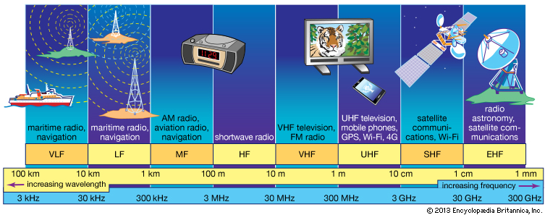
RF communication
IoT focus

Slide 49
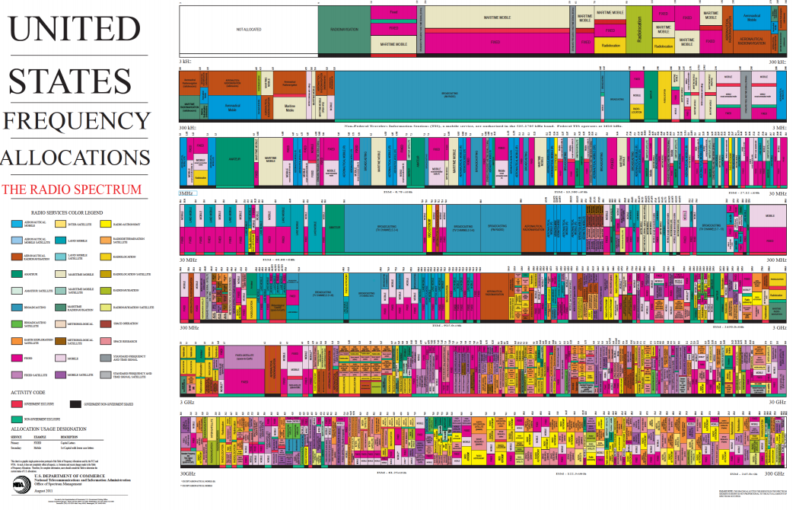
Wireless spectrum is allocated to specific uses

Slide 50
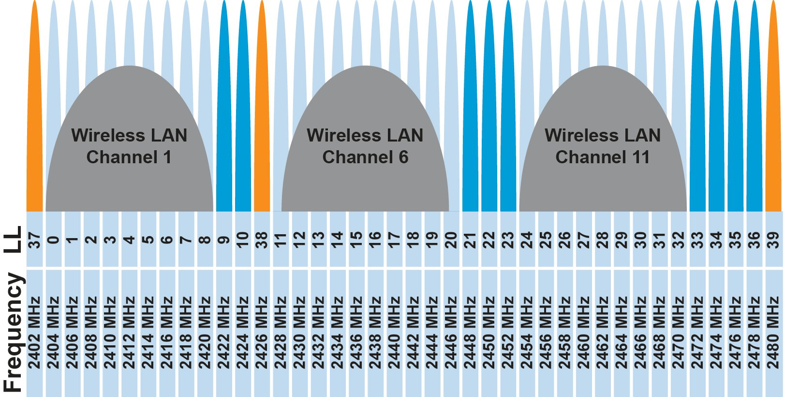
Unlicensed bands are where IoT thrives
902 MHz – 928 MHz
LPWANs
2.4 GHz to 2.5 GHz
WiFi, BLE, Thread
5 GHz
Faster WiFi
Cellular uses licensed bands

Slide 51
Model of RF communication
Energy that radiates spherically from an antenna
Attenuation with distance
Density of energy reduces over time, distance
Signal strength reduced, errors go up
Two key features
Error rates depend on distance
Spatial reuse of frequencies

Slide 52
Outline
Who and Why
Internet of Things
Course Overview
Overview of wireless networks

